Slide 1
Online Shopping
1.
2.
3.
4.
5.
6.
7.
8.
9.
10.
11.
12.
13.
14.
15.
16.
17.
18.
19.
20.
21
22.
23.
24.
24.
25.
</
} /> [
/>
Made by-
Anshuman Verma

Slide 2
About the Project
1.
2.
3.
4.
5.
6.
7.
8.
9.
10.
11.
12.
13.
14.
15.
16.
17.
18.
19.
20.
21
22.
23.
24.
24.
25.
Overview - The project is based on online shopping services, it provides the user with necessary filters and features to shop for their desired products. It is very intuitive and user – friendly, making it very helpful for shopping for all age groups.
Key features –
1.Login – One can gain access to the service by logging in, using their respective username and passwords.
2.Categories – The Items available are categorized, to make it easy for the user to find the product that best suits their needs.
3.Cart – The user has also been provided feature of adding their products into a cart which at checkout can shock them with bills

Slide 3
Commands used
1.
2.
3.
4.
5.
6.
7.
8.
9.
10.
11.
12.
13.
14.
15.
16.
17.
18.
19.
20.
21
22.
23.
24.
24.
25.
Several commands and functions that have come in use of the following project are out of syllabus. Above mentioned command are as follows –
global- ‘global’ is used to declare a variable globally from where all the functions can accesses it.
Def – the ‘def’ function is used to create functions which reduce the amount of code by a significant amount.
is_connected – ‘is_connected’ is used to make sure that the connection is established between python and mysql for complete and smooth functioning of the program.
Isinstance() – This function is used, in this project, to check if the entered quantity by the user is a valid integer.

Slide 4
Source Code
1.
2.
3.
4.
5.
6.
7.
8.
9.
10.
11.
12.
13.
14.
15.
16.
17.
18.
19.
20.
21
22.
23.
24.
24.
25.
(python)
import pandas as pd
import numpy as np
import mysql.connector as sqltor
mycon = sqltor.connect(host ="localhost",user = "root", passwd = "mysql", database = "login",autocommit = True)
cursor = mycon.cursor(buffered=True);
def start():
cursor.execute("select * from start")
products = cursor.fetchall();
print("------------------------------------------------------------------------------------------------------------------------")
print ("Sr_no \t\t\t| Category \t\t| Item_No\t|")
for row in products:
Sr_no = row[0]
Category = row[1]
Item_No = row[2]
print ("%s \t\t| %s \t\t| %s \t\t|" % (Sr_no, Category, Item_No))
print("----------------------------------------------------------------------------------------------------------")
global select
select = (input("Select the product/Category:")).lower()

Slide 5
Source Code
1.
2.
3.
4.
5.
6.
7.
8.
9.
10.
11.
12.
13.
14.
15.
16.
17.
18.
19.
20.
21
22.
23.
24.
24.
25.
def selection():
if select == "back":
login();
if select == "book" :
cursor.execute("select * from book")
books = cursor.fetchall();
print("------------------------------------------------------------------------------------------------------------------------")
print ("Sr_no \t\t\t| Product_code \t\t| Product Name \t\t| Publication\t\t|Product_rating \t\t| MRP_Per_product \t\t| Availability_of_product \t\t| In_stock ")
for row in books:
Sr_no = row[0]
Product_code = row[1]
Product_Name = row[2]
Publication = row[3]
Product_rating = row[4]
MSRP_Per_product = row[5]
Availability_of_product= row[6]
In_stock = row[7]
print ("%s \t\t| %s \t\t| %s \t\t| %s \t\t| %s \t\t| %s \t\t| %s \t\t| %s \t\t|" % (Sr_no, Product_code, Product_Name, Publication, Product_rating, MSRP_Per_product, Availability_of_product, In_stock));
print("----------------------------------------------------------------------------------------------------------")
Cart();
mycon.close();
elif select == "electronics":
cursor.execute("SELECT * FROM electronics")
electronics = cursor.fetchall()
print("------------------------------------------------------------------------------------------------------------------------")

Slide 6
Source Code
1.
2.
3.
4.
5.
6.
7.
8.
9.
10.
11.
12.
13.
14.
15.
16.
17.
18.
19.
20.
21
22.
23.
24.
24.
25.
print("Sr_no\t| Product_code\t\t| Product_Name\t\t| Brand \t\t|Price\t| Stock_quantity\t| Category\t| Rating\t| Description")
for row in electronics:
Sr_no = row[0]
Product_code = row[1]
Product_Name = row[2]
Brand = row[3]
Price_in_inr = row[4]
Avalability_of_product = row[5]
In_stock = row[6]
Product_rating = row[7]
print("%s\t\t| %s\t\t| %s\t\t| %s\t| %s\t\t| %s\t\t| %s\t\t|" % (Sr_no, Product_code, Product_Name, Brand, Price_in_inr, Avalability_of_product, In_stock));
print("------------------------------------------------------------------------------------------------------------------------");
Cart();
mycon.close();
elif select == "cosmetics":
cursor.execute("select * from cosmetics")
cosmetics = cursor.fetchall();
print("------------------------------------------------------------------------------------------------------------------------")
print ("Sr_no \t\t\t| Product_code \t\t| Product Name \t\t|Quantity \t\t| Price_in_Inr \t\t| Brand \t\t| Availabilit_of_Product \t\t|In_Stock\t\t|Product_rating ")
for row in cosmetics:
Sr_no = row[0]
Product_code = row[1]
Product_Name = row[2]
Quantity = row[3]
Price_in_Inr= row[4]
Brand= row[5]
Availability_of_product = row[6]

Slide 7
Source Code
1.
2.
3.
4.
5.
6.
7.
8.
9.
10.
11.
12.
13.
14.
15.
16.
17.
18.
19.
20.
21
22.
23.
24.
24.
25.
In_stock = row[7]
Product_rating = [8]
print ("%s \t\t| %s \t\t| %s \t\t| %s \t\t| %s \t\t| %s \t\t| %s \t\t| %s \t\t|" % (Sr_no, Product_code, Product_Name, Quantity, Price_in_Inr, Brand,Availability_of_product, In_stock,Product_rating));
print("----------------------------------------------------------------------------------------------------------")
Cart();
mycon.close();
elif select == "clothes":
cursor.execute("select * from clothes")
clothes= cursor.fetchall();
print("------------------------------------------------------------------------------------------------------------------------")
print ("Sr_no \t\t\t| Product_code \t\t| Product Name \t\t| Brand\t\t|Size \t\t| Price_in_inr \t\t| Availability_of_product \t\t| In_stock \t\t| Product_rating")
for row in clothes:
Sr_no = row[0]
Product_code = row[1]
Product_Name = row[2]
Brand = row[3]
Size = row[4]
Price_in_Inr= row[5]
Availability_of_product= row[6]
In_stock = row[7]
Product_rating = row[8]
print ("%s \t\t| %s \t\t| %s \t\t| %s \t\t| %s \t\t| %s \t\t| %s \t\t| %s \t\t| %s \t\t|" % (Sr_no, Product_code, Product_Name, Brand, Size, Price_in_Inr, Availability_of_product, In_stock,Product_rating));
print("----------------------------------------------------------------------------------------------------------")
Cart();
mycon.close();

Slide 8
Source Code
1.
2.
3.
4.
5.
6.
7.
8.
9.
10.
11.
12.
13.
14.
15.
16.
17.
18.
19.
20.
21
22.
23.
24.
24.
25.
elif select == "furniture":
cursor.execute("select * from furniture_home_decor")
furniture_home_decor = cursor.fetchall();
print("------------------------------------------------------------------------------------------------------------------------")
print ("Sr_no \t\t\t| Product_code \t\t| Product Name \t\t|Type \t\t| Price_in_Inr \t\t| Brand \t\t| Availabilit_of_Product \t\t| In_Stock,Product_rating")
for row in furniture_home_decor:
Sr_no = row[0]
Product_code = row[1]
Product_Name = row[2]
Type = row[3]
Price_in_Inr= row[4]
Brand = row[5]
Availability_of_product = row[6]
In_stock = row[7]
Product_rating = [8]
print ("%s \t\t| %s \t\t| %s \t\t| %s \t\t| %s \t\t| %s \t\t| %s \t\t| %s \t\t|" % (Sr_no, Product_code, Product_Name, Type, Price_in_Inr, Brand,Availability_of_product, In_stock, Product_rating));
print("----------------------------------------------------------------------------------------------------------")
Cart();
mycon.close();
elif select == "grocery":
cursor.execute("select * from grocery")
grocery = cursor.fetchall();
print("------------------------------------------------------------------------------------------------------------------------")
print ("Sr_no \t\t\t| Product_code \t\t| Product Name \t\t|Quantity \t\t| Price_in_Inr \t\t| Brand \t\t| Availabilit_of_Product \t\t|In_Stock\t\t|Product_rating")
for row in grocery:
Sr_no = row[0]
Product_code = row[1]

Slide 9
Source Code
1.
2.
3.
4.
5.
6.
7.
8.
9.
10.
11.
12.
13.
14.
15.
16.
17.
18.
19.
20.
21
22.
23.
24.
24.
25.
Product_Name = row[2]
Quantity = row[3]
Price_in_Inr= row[4]
Brand = row[5]
Availability_of_product = row[6]
In_stock = row[7]
Product_rating = [8]
print ("%s \t\t| %s \t\t| %s \t\t| %s \t\t| %s \t\t| %s \t\t| %s \t\t| %s \t\t|%s \t\t|" % (Sr_no, Product_code, Product_Name, Quantity, Price_in_Inr, Brand,Availability_of_product, In_stock, Product_rating));
print("----------------------------------------------------------------------------------------------------------")
Cart();
mycon.close();
elif select == "medicine":
cursor.execute("select * from medicinal_drugs")
medicinal_drugs = cursor.fetchall();
print("------------------------------------------------------------------------------------------------------------------------")
print ("Sr_no \t\t\t| Product_code \t\t| Product Name\t\t|Dosage \t\t| Price_in_Inr \t\t| Brand \t\t| Availabilit_of_Product \t\t| In_Stock\t\t|Product_rating")
for row in medicinal_drugs:
Sr_no = row[0]
Product_code = row[1]
Product_Name = row[2]
Dosage = row[3]
Price_in_Inr= row[4]
Brand = row[5]
Availability_of_product = row[6]
In_stock = row[7]
Product_rating = [8]
print ("%s \t\t| %s \t\t| %s \t\t| %s \t\t| %s \t\t| %s \t\t| %s \t\t| %s \t\t|" % (Sr_no, Product_code, Product_Name, Dosage, Price_in_Inr, Brand,Availability_of_product, In_stock, Product_rating));
print("----------------------------------------------------------------------------------------------------------")
Cart();

Slide 10
Source Code
1.
2.
3.
4.
5.
6.
7.
8.
9.
10.
11.
12.
13.
14.
15.
16.
17.
18.
19.
20.
21
22.
23.
24.
24.
25.
elif select== "stationary":
cursor.execute("select * from stationery")
stationery = cursor.fetchall();
print("------------------------------------------------------------------------------------------------------------------------")
print ("Sr_no \t\t\t| Product_code \t\t| Product Name\t\t|Type \t\t| Price_in_Inr \t\t| Brand \t\t| Availabilit_of_Product \t\t| In_Stock\t\t|Product_rating")
for row in stationery:
Sr_no = row[0]
Product_code = row[1]
Product_Name = row[2]
Type = row[3]
Price_in_Inr= row[4]
Brand = row[5]
Availability_of_product = row[6]
In_stock = row[7]
Product_rating = [8]
print ("%s \t\t| %s \t\t| %s \t\t| %s \t\t| %s \t\t| %s \t\t| %s \t\t| %s \t\t|" % (Sr_no, Product_code, Product_Name, Type, Price_in_Inr, Brand,Availability_of_product, In_stock, Product_rating));
print("-----------------------------------------------------------------------------------------------------------")
Cart();
mycon.close();
Availability_of_product = row[6]
In_stock = row[7]
Product_rating = [8]
print ("%s \t\t| %s \t\t| %s \t\t| %s \t\t| %s \t\t| %s \t\t| %s \t\t| %s \t\t| %s \t\t|" % (Sr_no, Product_code, Product_Name, Quantity, Price_in_Inr, Brand,Availability_of_product, In_stock, Product_rating));
print("----------------------------------------------------------------------------------------------------------")
Cart();
cursor.close();
elif select == "back":
start();

Slide 11
Source Code
1.
2.
3.
4.
5.
6.
7.
8.
9.
10.
11.
12.
13.
14.
15.
16.
17.
18.
19.
20.
21
22.
23.
24.
24.
25.
else:
print("Please enter a valid category")
start();
selection();
cursor.close();
def Cart():
global Cart_
Cart_ = input("Enter the serial number for your desired product: ")
if Cart_ == 'back':
start();
selection();
else:
asasd = cursor.execute("select product_code,product_name,Price_in_inr from %s where Sr_no = %s" % (select, Cart_))
indacart = cursor.fetchall()
print("------------------------------------------------------------------------------------------------------------------------")
print ("\t\t\t| Product_code \t\t| Product Name \t\t| MRP ")
global Product_Name
for row in indacart:
global Product_code
Product_code = row[0]
global Proudct_Name
Product_Name = row[1]
global MRP
MRP = row[2]
print ("%s \t\t| %s \t\t| %s \t\t| " % (Product_code, Product_Name,int(MRP)));
print("----------------------------------------------------------------------------------------------------------")

Slide 12
Source Code
1.
2.
3.
4.
5.
6.
7.
8.
9.
10.
11.
12.
13.
14.
15.
16.
17.
18.
19.
20.
21
22.
23.
24.
24.
25.
YON = (input("Do you want to add %s to the cart(Yes/No): " % (Product_Name))).lower()
cursor.execute("Insert into Cart (Product_code,Product_Name,MRP) values('%s','%s',%s)" % (Product_code, Product_Name,MRP))
print("'%s' is added to cart succesfully" % (Product_Name))
cursor.execute("select in_stock from %s where Sr_no = %s" % (select,Cart_))
in_stock = cursor.fetchall()
global instock
global qty
for row in in_stock:
global instock
instock = row[0]
break;
global qty
qty = input("How many %s do want in your cart?" % (Product_Name))
if isinstance(qty, int):
print("added")
elif qty == '':
print("Please Enter a valid quantity")
Cart();
break;
elif qty == 0:
print("Quantity can not be zero")
Cart();
elif int(qty) > int(instock):
print("Only %s units are(is) avaiable of %s, Now you will be redirected to the cart" % (qty,Product_Name))
Cart();
break;
cursor.execute("Update Cart set Quantity = %s where product_Name = '%s'" % (qty,Product_Name))
cursor.execute("Update cart set total = MRP*Quantity")
global PC
PC = Product_code
updation();
another_product();

Slide 13
Source Code
1.
2.
3.
4.
5.
6.
7.
8.
9.
10.
11.
12.
13.
14.
15.
16.
17.
18.
19.
20.
21
22.
23.
24.
24.
25.
def updation():
cursor.execute("select in_stock from %s where Sr_no = %s" % (select,Cart_))
in_stock = cursor.fetchall()
print(in_stock)
global instock
for row in in_stock:
global instock
instock = row[0]
print(instock)
updated = int(instock) - int(qty)
if updated == 0:
print("This Product in not instock")
cursor.execute("Update %s set Availability_of_product = 'Not Available' where Product_code = '%s'" % (select,Product_code));
cursor.execute("Update %s set In_stock = 0 where Product_code = '%s'" % (select,Product_code));
else:
cursor.execute("Update %s set In_stock = %s where product_code = '%s'" % (select,updated,PC))
mycon.commit();
def another_product():
product2 = input("Do you want to add another product to your cart?(Yes/No): ")
if product2 == "yes":
selection();
elif product2 == "no":
checkout();
else:
print("Please choose from yes or no")
another_product();

Slide 14
Source Code
1.
2.
3.
4.
5.
6.
7.
8.
9.
10.
11.
12.
13.
14.
15.
16.
17.
18.
19.
20.
21
22.
23.
24.
24.
25.
def total():
cursor.execute("Update cart set total = MRP*Quantity;")
mycon.commit()
cursor.execute("select sum(total) from cart")
global sum
sum = cursor.fetchall()
for row in sum:
summ_ = row[0]
print (" Your total sum is %s" % (summ_));
def checkout():
checkOut = cursor.execute("select * from cart")
indacart = cursor.fetchall()
print("------------------------------------------------------------------------------------------------------------------------")
print ("\t\t\t| Product_code \t\t| Product Name \t\t| MRP \t\t| Quantity \t\t| Total")
for row in indacart:
Product_code = row[0]
Product_Name = row[1]
MRP = row[2]
Quantity = row[3]
Total = row[4]
print ("%s \t\t| %s \t\t| %s \t\t| %s \t\t| " % (Product_code, Product_Name,int(MRP),Quantity),Total);
total();
print("------------------------------------------------------------------------------------------------------------------------")
cursor.close();

Slide 15
Source Code
1.
2.
3.
4.
5.
6.
7.
8.
9.
10.
11.
12.
13.
14.
15.
16.
17.
18.
19.
20.
21
22.
23.
24.
24.
25.
x = ['electronics','clothes','grocery','book','cosmetics','furniture','stationery','medicine','toygames’]
y = [231,417,1881,909,1778,1700,3570,1690,1685]
plt.xticks(fontsize=6)
plt.bar(x,y,color = ['r','c','k','y','m','c'])
plt.xlabel('Different Categories', fontsize=12)
plt.ylabel('Collection of items for each indivual category')
plt.title('Number of Items in stock for each category')
plt.figure(figsize=(50,50))
plt.show()
x = ['electronics','clothes','grocery','book','cosmetics','furniture','stationery','medicine','toygames’]
y = [106,240,496,104,68,153,98,162,134]
plt.xticks(fontsize=6)
plt.bar(x,y,color = ['r','c','k','y','m','c'])
plt.xlabel('Different Categories', fontsize=12)
plt.ylabel('Number of products sold')
plt.title('Number of Items sold in each category')
plt.figure(figsize=(50,50))
plt.show()

Slide 16
Source Code
1.
2.
3.
4.
5.
6.
7.
8.
9.
10.
11.
12.
13.
14.
15.
16.
17.
18.
19.
20.
21
22.
23.
24.
24.
25.
if mycon.is_connected():
print("Connected succesfully");
def login():
username = input("Enter your username: ")
password = input("Enter your password: ")
sql = "SELECT * FROM login"
cursor.execute(sql)
results = cursor.fetchall()
for row in results:
user,pwd = row[0],row[1]
if username == user and password == pwd:
print("Login successful!")
global qt
qt =5
break
else:
qt = 6
print("Invalid username or password. Please try again.")
return;
login();
return;
login();
if qt ==5:
start();
selection();
cursor.close();
else:
print("Login Unsuccesful mate!")

Slide 17
Source Code
(MySQL)
1.
2.
3.
4.
5.
6.
7.
8.
9.
10.
11.
12.
13.
14.
15.
16.
17.
18.
19.
20.
21
22.
23.
24.
24.
25.
CREATE TABLE BOOK (
Sr_no INT ,
Product_code VARCHAR(20) PRIMARY KEY,
Product_name VARCHAR(255) NOT NULL,
Publication VARCHAR(100) NOT NULL,
Product_rating NUMERIC,
MRP_Per_product NUMERIC(10, 2) NOT NULL,
Availability_of_product VARCHAR(15),
In_stock INT);
INSERT INTO BOOK (Sr_no, Product_code, Product_name, Publication, MRP_Per_product, Availability_of_product, In_stock, Product_rating) VALUES (1, 'ASD123', 'The Book Thief', 'Knopf', 1798, 'Available', 21, 3),
(2, 'ASD234', 'The Time Traveler''s Wife', 'MacAdam/Cage', 1498, 'Available', 27, 4),
(3, 'ASD345', 'Atonement', 'Jonathan Cape', 1398, 'Available', 24, 2),
(4, 'ASD456', 'The Grapes of Wrath', 'The Viking Press', 1398, 'Available', 29, 5),
(5, 'ASD567', 'The Little Prince', 'Reynal & Hitchcock', 1498, 'Available', 44, 1),
(6, 'ASD678', 'The Brothers Karamazov', 'The Russian Messenger', 1598, 'Available', 69, 3),
(7, 'ASD789', 'The Name of the Wind', 'DAW Books', 1698, 'Available', 56, 4),
(8, 'ASD890', 'The Martian', 'Crown Publishing', 1198, 'Available', 52, 2),
(9, 'QUE123', 'The Catcher in the Rye', 'Little, Brown and Company', 1098, 'Available', 55, 5),
(10, 'QUE234', 'The Road', 'Alfred A. Knopf', 1098, 'Available', 62, 1),
(11, 'QUE345', 'The Hobbit', 'George Allen & Unwin', 1598, 'Available', 67, 4),
(12, 'QUE456', 'Dune', 'Chilton Books', 1298, 'Available', 48, 3),
(13, 'QUE567', 'The Night Circus', 'Doubleday', 1298, 'Available', 42, 2),
(14, 'QUE678', 'Siddhartha', 'New Directions', 1898, 'Available', 68, 5),

Slide 18
Source Code
(MySQL)
1.
2.
3.
4.
5.
6.
7.
8.
9.
10.
11.
12.
13.
14.
15.
16.
17.
18.
19.
20.
21
22.
23.
24.
24.
25.
(15, 'YVH123', 'The Secret Garden', 'Frederick A. Stokes Company', 1098, 'Available', 63, 1),
(16, 'YVH234', 'The Time Machine', 'William Heinemann', 1398, 'Available', 43, 4),
(17, 'YVH345', 'The Grapes of Wrath', 'The Viking Press', 1398, 'Available', 29, 3),
(18, 'YVH456', 'The Martian', 'Crown Publishing', 1198, 'Available', 52, 2),
(19, 'YVH567', 'The Time Traveler''s Wife', 'MacAdam/Cage', 1498, 'Available', 27, 5),
(20, 'YVH678', 'The Ocean at the End of the Lane', 'William Morrow', 1698, 'Available', 31, 1);
CREATE TABLE ELECTRONICS (
Sr_no INT AUTO_INCREMENT PRIMARY KEY,
Product_code VARCHAR(10) NOT NULL,
Product_name VARCHAR(255) NOT NULL,
Brand VARCHAR(255) NOT NULL,
Price_in_inr DECIMAL(10, 2) NOT NULL, Availability_of_product VARCHAR(50) NOT NULL,
In_stock INT NOT NULL,
Product_rating INT);
INSERT INTO ELECTRONICS (Sr_no, Product_code, Product_name, Brand, Price_in_inr, Availability_of_product, In_stock, Product_rating) VALUES (1, 'ELC001', 'Samsung Galaxy S21', 'Samsung', 48749.25, 'Available', 14, 5), (2, 'ELC002', 'Apple iPhone 13', 'Apple', 59999.25, 'Available', 15, 4), (3, 'ELC003', 'Dell XPS 13 Laptop', 'Dell', 82499.25, 'Available', 10, 3), (4, 'ELC004', 'Sony PlayStation 5', 'Sony', 33749.25, 'Available', 8, 4), (5, 'ELC005', 'Bose Noise-Canceling Headphones', 'Bose', 22499.25, 'Available', 20, 5), (6, 'ELC006', 'Canon EOS R6 Camera', 'Canon', 172499.25, 'Available', 5, 3), (7, 'ELC007', 'Xbox Series X', 'Microsoft', 33749.25, 'Available', 12, 4), (8, 'ELC008', 'LG OLED 4K TV', 'LG', 93749.25, 'Available', 18, 5), (9, 'ELC009', 'Sony WH-1000XM4 Headphones', 'Sony', 22499.25, 'Available', 30, 4), (10, 'ELC010', 'HP Spectre x360 Laptop', 'HP', 71249.25, 'Available', 6, 3);

Slide 19
Source Code
(MySQL)
1.
2.
3.
4.
5.
6.
7.
8.
9.
10.
11.
12.
13.
14.
15.
16.
17.
18.
19.
20.
21
22.
23.
24.
24.
25.
(11, 'ELC011', 'Apple AirPods Pro', 'Apple', 14249.25, 'Available', 24, 5), (12, 'ELC012', 'Nvidia GeForce RTX 3080', 'Nvidia', 44999.25, 'Available', 4, 4), (13, 'ELC013', 'Samsung Smart TV', 'Samsung', 44999.25, 'Available', 25, 3), (14, 'ELC014', 'Canon EOS R5 Camera', 'Canon', 262499.25, 'Available', 3, 4), (15, 'ELC015', 'DJI Mavic Air 2 Drone', 'DJI', 56249.25, 'Available', 9, 5), (16, 'ELC016', 'Xiaomi Mi 11 Smartphone', 'Xiaomi', 41249.25, 'Available', 11, 4), (17, 'ELC017', 'Logitech G Pro X Keyboard', 'Logitech', 10499.25, 'Available', 22, 5), (18, 'ELC018', 'Acer Predator Helios 300', 'Acer', 74999.25, 'Available', 7, 4), (19, 'ELC019', 'Google Pixel 6', 'Google', 44999.25, 'Available', 13, 3), (20, 'ELC020', 'Panasonic Lumix GH5 Camera', 'Panasonic', 142499.25, 'Available', 2, 4);
CREATE TABLE UTENSILS (
Sr_no INT AUTO_INCREMENT PRIMARY KEY,
Product_code VARCHAR(10) NOT NULL,
Product_name VARCHAR(255) NOT NULL,
Quantity VARCHAR(20) NOT NULL,
Price_in_inr DECIMAL(10, 2) NOT NULL,
Brand VARCHAR(255) NOT NULL,
Availability_of_product VARCHAR(50) NOT NULL,
In_stock INT NOT NULL,
Product_rating INT);
INSERT INTO UTENSILS (Product_code, Product_name, Quantity, Price_in_inr, Brand, Availability_of_product, In_stock, Product_rating) VALUES ('UTN001', 'Cookware Set', '10 pieces', 599.99, 'Cuisinart', 'Available', 50, 4), ('UTN002', 'Cutlery Set', '20 pieces', 199.99, 'Oneida', 'Available', 80, 5), ('UTN003', 'Non-Stick Pan', '1 piece', 49.99, 'T-fal', 'Available', 120, 4), ('UTN004', 'Pressure Cooker', '5 liters', 89.99, 'Hawkins', 'Available', 70, 5), ('UTN005', 'Kitchen Knife Set', '7 pieces', 39.99, 'J.A. Henckels', 'Available', 60, 4), ('UTN006', 'Cooking Utensils', '8 pieces', 29.99, 'OXO', 'Available', 100, 5);

Slide 20
Source Code
(MySQL)
1.
2.
3.
4.
5.
6.
7.
8.
9.
10.
11.
12.
13.
14.
15.
16.
17.
18.
19.
20.
21
22.
23.
24.
24.
25.
), ('UTN007', 'Bakeware Set', '6 pieces', 79.99, 'Calphalon', 'Available', 45, 4), ('UTN008', 'Dinnerware Set', '16 pieces', 129.99, 'Corelle', 'Available', 70, 5), ('UTN009', 'Glassware Set', '12 pieces', 59.99, 'Libbey', 'Available', 90, 4), ('UTN010', 'Tea Kettle', '1 piece', 24.99, 'Mr. Coffee', 'Available', 110, 5), ('UTN011', 'Toaster', '1 piece', 34.99, 'Hamilton Beach', 'Available', 75, 4), ('UTN012', 'Dish Rack', '1 piece', 19.99, 'Simplehuman', 'Available', 85, 4), ('UTN013', 'Food Storage Containers', '12 pieces', 29.99, 'Rubbermaid', 'Available', 95, 5), ('UTN014', 'Mixing Bowls', '5 pieces', 14.99, 'Pyrex', 'Available', 100, 4), ('UTN015', 'Pressure Cooker', '3 liters', 59.99, 'Prestige', 'Available', 65, 5), ('UTN016', 'Can Opener', '1 piece', 9.99, 'OXO', 'Available', 110, 4), ('UTN017', 'Peeler', '1 piece', 5.99, 'Kuhn Rikon', 'Available', 75, 4), ('UTN018', 'Colander', '1 piece', 12.99, 'Farberware', 'Available', 90, 5), ('UTN019', 'Spatula Set', '3 pieces', 7.99, 'Tovolo', 'Available', 80, 5), ('UTN020', 'Strainer', '1 piece', 9.99, 'Cuisinart', 'Available', 70, 4);
CREATE TABLE COSMETICS (
Sr_no INT AUTO_INCREMENT PRIMARY KEY,
Product_code VARCHAR(10) NOT NULL,
Product_name VARCHAR(255) NOT NULL,
Quantity VARCHAR(20) NOT NULL,
Price_in_inr DECIMAL(10, 2) NOT NULL,
Brand VARCHAR(255) NOT NULL,
Availability_of_product VARCHAR(50) NOT NULL,
In_stock INT NOT NULL,
Product_rating INT);
INSERT INTO COSMETICS (Product_code, Product_name, Quantity, Price_in_inr, Brand, Availability_of_product, In_stock, Product_rating) VALUES ('COS001', 'Foundation', '30ml', 39.99, 'Maybelline', 'Available', 100, 5), ('COS002', 'Lipstick', '4g', 14.99, 'LOréal', 'Available', 120, 4),

Slide 21
Source Code
(MySQL)
1.
2.
3.
4.
5.
6.
7.
8.
9.
10.
11.
12.
13.
14.
15.
16.
17.
18.
19.
20.
21
22.
23.
24.
24.
25.
('COS003', 'Mascara', '8ml', 19.99, 'CoverGirl', 'Available', 80, 4), ('COS004', 'Eyeshadow Palette', '12g', 29.99, 'Urban Decay', 'Available', 90, 5), ('COS005', 'Blush', '10g', 12.99, 'Revlon', 'Available', 60, 4), ('COS006', 'Concealer', '5g', 9.99, 'NYX', 'Available', 110, 4), ('COS007', 'Makeup Brushes Set', '10 pieces', 24.99, 'Real Techniques', 'Available', 75, 5), ('COS008', 'Nail Polish', '10ml', 7.99, 'Essie', 'Available', 85, 4), ('COS009', 'Facial Cleanser', '150ml', 15.99, 'Neutrogena', 'Available', 70, 5), ('COS010', 'Shampoo', '250ml', 9.99, 'LOreal Paris', 'Available', 60, 4), ('COS011', 'Conditioner', '250ml', 9.99, 'Pantene', 'Available', 70, 4), ('COS012', 'Body Lotion', '200ml', 12.99, 'Nivea', 'Available', 110, 4), ('COS013', 'Sunscreen', '50ml', 19.99, 'Coppertone', 'Available', 80, 5), ('COS014', 'Perfume', '50ml', 34.99, 'Calvin Klein', 'Available', 120, 5), ('COS015', 'Facial Moisturizer', '50ml', 14.99, 'Olay', 'Available', 100, 4), ('COS016', 'Lip Balm', '4g', 5.99, 'Burts Bees', 'Available', 90, 5), ('COS017', 'Hair Styling Gel', '150ml', 9.99, 'Garnier', 'Available', 70, 4), ('COS018', 'Deodorant', '150ml', 6.99, 'Dove', 'Available', 110, 4), ('COS019', 'Face Mask', '100ml', 7.99, 'Freeman', 'Available', 85, 4), ('COS020', 'Eye Cream', '15ml', 18.99, 'LOreal Paris', 'Available', 95, 5);
CREATE TABLE FURNITURE_HOME_DECOR (
Sr_no INT AUTO_INCREMENT PRIMARY KEY,
Product_code VARCHAR(10) NOT NULL,
Product_name VARCHAR(255) NOT NULL,
Category VARCHAR(50) NOT NULL,
Price_in_inr DECIMAL(10, 2) NOT NULL,
Brand VARCHAR(255) NOT NULL,
Availability_of_product VARCHAR(50) NOT NULL,
In_stock INT NOT NULL,
Product_rating INT);

Slide 22
Source Code
(MySQL)
1.
2.
3.
4.
5.
6.
7.
8.
9.
10.
11.
12.
13.
14.
15.
16.
17.
18.
19.
20.
21
22.
23.
24.
24.
25.
INSERT INTO FURNITURE_HOME_DECOR (Product_code, Product_name, Category, Price_in_inr, Brand, Availability_of_product, In_stock, Product_rating) VALUES ('FH001', 'Sofa', 'Furniture', 49999.99, 'Ashley Furniture', 'Available', 50, 4);
('FH002', 'Coffee Table', 'Furniture', 7999.99, 'IKEA', 'Available', 80, 5), ('FH003', 'Dining Set', 'Furniture', 14999.99, 'Rooms To Go', 'Available', 70, 4), ('FH004', 'Bed Frame', 'Furniture', 8999.99, 'Wayfair', 'Available', 100, 4), ('FH005', 'Wardrobe', 'Furniture', 12999.99, 'Broyhill', 'Available', 60, 4), ('FH006', 'Lamp', 'Home Decor', 299.99, 'Threshold', 'Available', 110, 5), ('FH007', 'Wall Art', 'Home Decor', 499.99, 'Pier 1', 'Available', 75, 4), ('FH008', 'Bookshelf', 'Furniture', 2999.99, 'Ethan Allen', 'Available', 85, 4), ('FH009', 'Accent Chair', 'Furniture', 3999.99, 'Havertys', 'Available', 60, 4), ('FH010', 'Rug', 'Home Decor', 799.99, 'Safavieh', 'Available', 110, 4), ('FH011', 'Desk', 'Furniture', 1999.99, 'Bush Furniture', 'Available', 70, 4), ('FH012', 'Nightstand', 'Furniture', 699.99, 'Signature Design by Ashley', 'Available', 90, 5), ('FH013', 'Vase', 'Home Decor', 199.99, 'CB2', 'Available', 80, 5), ('FH014', 'Kitchen Table', 'Furniture', 3499.99, 'Crate and Barrel', 'Available', 85, 4), ('FH015', 'Curtains', 'Home Decor', 399.99, 'Lowe''s', 'Available', 100, 4), ('FH016', 'Shoe Rack', 'Furniture', 599.99, 'Walmart', 'Available', 95, 4), ('FH017', 'Mirrors', 'Home Decor', 449.99, 'HomeGoods', 'Available', 120, 5), ('FH018', 'Dresser', 'Furniture', 1799.99, 'Big Lots', 'Available', 70, 5), ('FH019', 'Side Table', 'Furniture', 699.99, 'Rooms To Go', 'Available', 80, 4), ('FH020', 'Wall Clock', 'Home Decor', 249.99, 'Hobby Lobby', 'Available', 110, 4),

Slide 23
Source Code
(MySQL)
1.
2.
3.
4.
5.
6.
7.
8.
9.
10.
11.
12.
13.
14.
15.
16.
17.
18.
19.
20.
21
22.
23.
24.
24.
25.
CREATE TABLE STATIONERY (
Sr_no INT AUTO_INCREMENT PRIMARY KEY,
Product_code VARCHAR(10) NOT NULL,
Product_name VARCHAR(255) NOT NULL,
Type VARCHAR(50) NOT NULL,
Price_in_inr DECIMAL(10, 2) NOT NULL,
Brand VARCHAR(255) NOT NULL,
Availability_of_product VARCHAR(50) NOT NULL,
In_stock INT NOT NULL,
Product_rating INT);
INSERT INTO STATIONERY (Product_code, Product_name, Type, Price_in_inr, Brand, Availability_of_product, In_stock, Product_rating) VALUES ('ST001', 'Notebook - Ruled', 'Notebooks', 199.99, 'Mead', 'Available', 150, 4), ('ST002', 'Pens - Pack of 10', 'Pens', 49.99, 'BIC', 'Available', 200, 5), ('ST003', 'Highlighters - Set of 6', 'Highlighters', 79.99, 'Sharpie', 'Available', 180, 4), ('ST004', 'Binder - 3-inch', 'Binders', 99.99, 'Avery', 'Available', 120, 4), ('ST005', 'Sticky Notes - Pack of 100', 'Sticky Notes', 39.99, 'Post-it', 'Available', 140, 4), ('ST006', 'Markers - Set of 12', 'Markers', 69.99, 'Crayola', 'Available', 160, 5), ('ST007', 'Scissors', 'Scissors', 19.99, 'Fiskars', 'Available', 190, 4), ('ST008', 'Ruler - 12-inch', 'Rulers', 9.99, 'Westcott', 'Available', 210, 4), ('ST009', 'Notebook - Plain', 'Notebooks', 199.99, 'Moleskine', 'Available', 130, 4), ('ST010', 'Erasers - Pack of 3', 'Erasers', 14.99, 'Paper Mate', 'Available', 220, 5), ('ST011', 'Whiteboard Markers - Set of 4', 'Markers', 49.99, 'Expo', 'Available', 170, 4), ('ST012', 'Desk Organizer', 'Desk Accessories', 39.99, 'Rolodex', 'Available', 190, 5), ('ST013', 'Correction Tape - Pack of 3', 'Correction Supplies', 29.99, 'Tombow', 'Available', 200, 4), ('ST014', 'Pencils - Pack of 12', 'Pencils', 19.99, 'Ticonderoga', 'Available', 210, 4), ('ST015', 'Crayons - Set of 24', 'Crayons', 29.99, 'Crayola', 'Available', 180, 4);

Slide 24
Source Code
(MySQL)
1.
2.
3.
4.
5.
6.
7.
8.
9.
10.
11.
12.
13.
14.
15.
16.
17.
18.
19.
20.
21
22.
23.
24.
24.
25.
('ST016', 'Hole Puncher', 'Desk Accessories', 24.99, 'Swingline', 'Available', 220, 5), ('ST017', 'Calculator - Basic', 'Calculators', 49.99, 'Texas Instruments', 'Available', 160, 5), ('ST018', 'Stapler', 'Desk Accessories', 19.99, 'Swingline', 'Available', 190, 4), ('ST019', 'Notebook - Graph', 'Notebooks', 199.99, 'Cambridge', 'Available', 140, 5), ('ST020', 'Pencil Sharpener', 'Pencil Sharpeners', 9.99, 'X-ACTO', 'Available', 210, 4);
CREATE TABLE MEDICINAL_DRUGS (
Sr_no INT AUTO_INCREMENT PRIMARY KEY,
Product_code VARCHAR(10) NOT NULL,
Product_name VARCHAR(255) NOT NULL,
Dosage VARCHAR(20) NOT NULL,
Price_in_inr DECIMAL(10, 2) NOT NULL, Brand VARCHAR(255) NOT NULL,
Availability_of_product VARCHAR(50) NOT NULL,
In_stock INT NOT NULL, Product_rating INT);
INSERT INTO MEDICINAL_DRUGS (Product_code, Product_name, Dosage, Price_in_inr, Brand, Availability_of_product, In_stock, Product_rating) VALUES ('MD001', 'Aspirin', '100mg', 299.99, 'Bayer', 'Available', 200, 4), ('MD002', 'Ibuprofen', '200mg', 349.99, 'Advil', 'Available', 150, 4), ('MD003', 'Loratadine', '10mg', 259.99, 'Claritin', 'Available', 180, 5), ('MD004', 'Amoxicillin', '500mg', 499.99, 'Amoxil', 'Available', 100, 5), ('MD005', 'Omeprazole', '20mg', 449.99, 'Prilosec', 'Available', 120, 4), ('MD006', 'Simvastatin', '40mg', 299.99, 'Zocor', 'Available', 100, 5), ('MD007', 'Metoprolol', '25mg', 269.99, 'Lopressor', 'Available', 90, 4), ('MD008', 'Lisinopril', '10mg', 229.99, 'Zestril', 'Available', 110, 4), ('MD009', 'Levothyroxine', '100mcg', 299.99, 'Synthroid', 'Available', 70, 5), ('MD010', 'Prednisone', '5mg', 249.99, 'Deltasone', 'Available', 80, 4), ('MD011', 'Acetaminophen', '500mg', 249.99, 'Tylenol', 'Available', 95, 4),

Slide 25
Source Code
(MySQL)
1.
2.
3.
4.
5.
6.
7.
8.
9.
10.
11.
12.
13.
14.
15.
16.
17.
18.
19.
20.
21
22.
23.
24.
24.
25.
('MD012', 'Cetirizine', '10mg', 299.99, 'Zyrtec', 'Available', 120, 4), ('MD013', 'Azithromycin', '250mg', 399.99, 'Z-Pak', 'Available', 80, 5), ('MD014', 'Ranitidine', '150mg', 259.99, 'Zantac', 'Available', 110, 5), ('MD015', 'Fluoxetine', '20mg', 279.99, 'Prozac', 'Available', 85, 4);
CREATE TABLE TOYS_GAMES (
Sr_no INT AUTO_INCREMENT PRIMARY KEY,
Product_code VARCHAR(10) NOT NULL,
Product_name VARCHAR(255) NOT NULL,
Quantity VARCHAR(20) NOT NULL,
Price_in_inr DECIMAL(10, 2) NOT NULL,
Brand VARCHAR(255) NOT NULL,
Availability_of_product VARCHAR(50) NOT NULL,
In_stock INT NOT NULL, Product_rating INT);
INSERT INTO TOYS_GAMES (Product_code, Product_name, Quantity, Price_in_inr, Brand, Availability_of_product, In_stock, Product_rating) VALUES ('TG001', 'Board Game - Monopoly', '1 set', 699.99, 'Hasbro', 'Available', 50, 4), ('TG002', 'LEGO Classic Bricks', '1000 pieces', 799.99, 'LEGO', 'Available', 80, 5), ('TG003', 'Action Figures - Spider-Man', '1 figure', 599.99, 'Marvel', 'Available', 120, 4), ('TG004', 'Puzzle - 1000 Pieces', '1 puzzle', 649.99, 'Ravensburger', 'Available', 60, 4), ('TG005', 'Dollhouse with Furniture', '1 set', 1799.99, 'KidKraft', 'Available', 110, 5), ('TG006', 'Remote Control Car', '1 car', 1199.99, 'Traxxas', 'Available', 75, 4), ('TG007', 'Building Blocks - Mega Set', '200 pieces', 799.99, 'Mega Bloks', 'Available', 85, 4), ('TG008', 'Foosball Table', '1 table', 1799.99, 'Hathaway', 'Available', 70, 5), ('TG009', 'Art Supplies Set', '50 pieces', 599.99, 'Crayola', 'Available', 100, 4), ('TG010', 'Bicycle - Kids', '1 bicycle', 1299.99, 'Schwinn', 'Available', 65, 5), ('TG011', 'Dartboard Set', '1 set', 899.99, 'Winmau', 'Available', 90, 4),

Slide 26
Source Code
(MySQL)
1.
2.
3.
4.
5.
6.
7.
8.
9.
10.
11.
12.
13.
14.
15.
16.
17.
18.
19.
20.
21
22.
23.
24.
24.
25.
('TG012', 'Science Kit - Volcano', '1 kit', 599.99, 'National Geographic', 'Available', 70, 4), ('TG013', 'LEGO Friends Set', '300 pieces', 699.99, 'LEGO', 'Available', 110, 5), ('TG014', 'RC Helicopter', '1 helicopter', 799.99, 'Syma', 'Available', 80, 5), ('TG015', 'Toy Kitchen Set', '1 set', 1199.99, 'Step2', 'Available', 90, 4), ('TG016', 'Giant Jenga Game', '1 set', 599.99, 'GoSports', 'Available', 75, 4), ('TG017', 'Play-Doh Set', '20 colors', 599.99, 'Play-Doh', 'Available', 100, 5), ('TG018', 'Remote Control Boat', '1 boat', 799.99, 'Traxxas', 'Available', 60, 4), ('TG019', 'Soccer Ball', '1 ball', 549.99, 'Nike', 'Available', 110, 4), ('TG020', 'Chess Set', '1 set', 599.99, 'Staunton', 'Available', 85, 5);
CREATE TABLE GROCERY(
Sr_no INT AUTO_INCREMENT PRIMARY KEY,
Product_code VARCHAR(10) NOT NULL,
Product_name VARCHAR(255) NOT NULL, Quantity VARCHAR(20) NOT NULL,
Price_in_inr DECIMAL(10, 2) NOT NULL,
Brand VARCHAR(255) NOT NULL,
Availability_of_product VARCHAR(50) NOT NULL,
In_stock INT NOT NULL, Product_rating INT);
INSERT INTO GROCERY (Product_code, Product_name, Quantity, Price_in_inr, Brand, Availability_of_product, In_stock, Product_rating) VALUES ('GRC001', 'Rice', '5kg', 249.99, 'Daawat', 'Available', 120, 4), ('GRC002', 'Wheat Flour', '2kg', 79.99, 'Aashirvaad', 'Available', 150, 5), ('GRC003', 'Sugar', '2kg', 54.99, 'Tata', 'Available', 110, 4), ('GRC004', 'Salt', '1kg', 19.99, 'Tata', 'Available', 130, 4), ('GRC005', 'Cooking Oil', '1L', 89.99, 'Fortune', 'Available', 80, 5), ('GRC006', 'Lentils', '1kg', 69.99, 'Kohinoor', 'Available', 90, 5), ('GRC007', 'Pasta', '500g', 49.99, 'Maggi', 'Available', 70, 4), ('GRC008', 'Canned Vegetables', '400g', 29.99, 'Dole', 'Available', 100, 4),

Slide 27
Source Code
(MySQL)
1.
2.
3.
4.
5.
6.
7.
8.
9.
10.
11.
12.
13.
14.
15.
16.
17.
18.
19.
20.
21
22.
23.
24.
24.
25.
('GRC009', 'Instant Coffee', '200g', 99.99, 'Bru', 'Available', 80, 5), ('GRC010', 'Tea Bags', '100pcs', 69.99, 'Red Label', 'Available', 100, 4), ('GRC011', 'Pasta Sauce', '500g', 49.99, 'Classico', 'Available', 70, 4), ('GRC012', 'Breakfast Cereal', '500g', 69.99, 'Kelloggs', 'Available', 90, 5), ('GRC013', 'Milk', '1L', 34.99, 'Amul', 'Available', 100, 4), ('GRC014', 'Bread', '400g', 24.99, 'Britannia', 'Available', 120, 4), ('GRC015', 'Jam', '250g', 39.99, 'Kissan', 'Available', 60, 5), ('GRC016', 'Butter', '200g', 59.99, 'Amul', 'Available', 70, 5), ('GRC017', 'Yogurt', '500g', 29.99, 'Nestlé', 'Available', 80, 4), ('GRC018', 'Cheese', '250g', 54.99, 'Amul', 'Available', 65, 4), ('GRC019', 'Instant Noodles', '300g', 19.99, 'Maggi', 'Available', 110, 4), ('GRC020', 'Spaghetti', '500g', 39.99, 'Barilla', 'Available', 100, 5);
CREATE TABLE CLOTHES (
Sr_no INT PRIMARY KEY,
Product_code VARCHAR(10) NOT NULL,
Product_name VARCHAR(255) NOT NULL,
Brand VARCHAR(255) NOT NULL,
Size VARCHAR(20) NOT NULL,
Price_in_inr DECIMAL(10, 2) NOT NULL, Availability_of_product VARCHAR(50) NOT NULL,
In_stock INT NOT NULL, Product_rating INT);
INSERT INTO CLOTHES (Sr_no,Product_code, Product_name, Brand, Size, Price_in_inr, Availability_of_product, In_stock, Product_rating) VALUES (1,'CLT001', 'Mens Blue Jeans', 'Levis', '32W x 34L', 17499.93, 'Available', 50, 4), (2,'CLT002', 'Womens Floral Dress', 'Zara', 'Medium', 10499.93, 'Available', 30, 5), (3,'CLT003', 'Mens Casual Shirt', 'Gap', 'Large', 6999.93, 'Available', 40, 4), (4,'CLT004', 'Womens Running Shoes', 'Nike', 'US 7', 13999.93, 'Available', 20, 4), (5,'CLT005', 'Mens Formal Suit', 'Hugo Boss', '42R', 34999.93, 'Available', 10, 5),

Slide 28
Source Code
(MySQL)
1.
2.
3.
4.
5.
6.
7.
8.
9.
10.
11.
12.
13.
14.
15.
16.
17.
18.
19.
20.
21
22.
23.
24.
24.
25.
(6,'CLT006', 'Womens Sweater', 'H&M', 'Small', 5599.93, 'Available', 25, 4), (7,'CLT007', 'Mens Athletic Shorts', 'Adidas', 'Large', 4899.93, 'Available', 35, 3), (8,'CLT008', 'Womens Denim Jacket', 'Calvin Klein', 'Medium', 7699.93, 'Available', 15, 4), (9,'CLT009', 'Mens Polo T-shirt', 'Ralph Lauren', 'Large', 4549.93, 'Available', 45, 4), (10,'CLT010', 'Womens Leather Boots', 'Timberland', 'US 8.5', 17499.93, 'Available', 22, 5), (11,'CLT011', 'Womens Summer Dress', 'Foreverg 21', 'Small', 999.93, 'Available', 28, 4), (12,'CLT012', 'Mens Classic Trousers', 'Dockers', '34W x 32L', 899.93, 'Available', 38, 4), (13,'CLT013', 'Womens Hooded Sweatshirt', 'Gap', 'Medium', 1199.93, 'Available', 19, 5), (14,'CLT014', 'Mens Running Shoes', 'New Balance', 'US 9', 1799.93, 'Available', 14, 4), (15,'CLT015', 'Womens Denim Skirt', 'Levis', '28', 799.93, 'Available', 32, 4);
CREATE TABLE BOOK (
Sr_no INT ,
Product_code VARCHAR(20) PRIMARY KEY,
Product_name VARCHAR(255) NOT NULL,
Publication VARCHAR(100) NOT NULL,
Product_rating NUMERIC,
MRP_Per_product NUMERIC(10, 2) NOT NULL, Availability_of_product VARCHAR(15),
In_stock INT);
INSERT INTO BOOK (Sr_no, Product_code, Product_name, Publication, MRP_Per_product, Availability_of_product, In_stock, Product_rating) VALUES (1, 'ASD123', 'The Book Thief', 'Knopf', 1798, 'Available', 21, 3), (2, 'ASD234', 'The Time Traveler''s Wife', 'MacAdam/Cage', 1498, 'Available', 27, 4), (3, 'ASD345', 'Atonement', 'Jonathan Cape', 1398, 'Available', 24, 2), (4, 'ASD456', 'The Grapes of Wrath', 'The Viking Press', 1398, 'Available', 29, 5),

Slide 29
Source Code
(MySQL)
1.
2.
3.
4.
5.
6.
7.
8.
9.
10.
11.
12.
13.
14.
15.
16.
17.
18.
19.
20.
21
22.
23.
24.
24.
25.
(5, 'ASD567', 'The Little Prince', 'Reynal & Hitchcock', 1498, 'Available', 44, 1), (6, 'ASD678', 'The Brothers Karamazov', 'The Russian Messenger', 1598, 'Available', 69, 3), (7, 'ASD789', 'The Name of the Wind', 'DAW Books', 1698, 'Available', 56, 4), (8, 'ASD890', 'The Martian', 'Crown Publishing', 1198, 'Available', 52, 2), (9, 'QUE123', 'The Catcher in the Rye', 'Little, Brown and Company', 1098, 'Available', 55, 5), (10, 'QUE234', 'The Road', 'Alfred A. Knopf', 1098, 'Available', 62, 1), (11, 'QUE345', 'The Hobbit', 'George Allen & Unwin', 1598, 'Available', 67, 4), (12, 'QUE456', 'Dune', 'Chilton Books', 1298, 'Available', 48, 3), (13, 'QUE567', 'The Night Circus', 'Doubleday', 1298, 'Available', 42, 2), (14, 'QUE678', 'Siddhartha', 'New Directions', 1898, 'Available', 68, 5), (15, 'YVH123', 'The Secret Garden', 'Frederick A. Stokes Company', 1098, 'Available', 63, 1), (16, 'YVH234', 'The Time Machine', 'William Heinemann', 1398, 'Available', 43, 4), (17, 'YVH345', 'The Grapes of Wrath', 'The Viking Press', 1398, 'Available', 29, 3), (18, 'YVH456', 'The Martian', 'Crown Publishing', 1198, 'Available', 52, 2), (19, 'YVH567', 'The Time Traveler''s Wife', 'MacAdam/Cage', 1498, 'Available', 27, 5), (20, 'YVH678', 'The Ocean at the End of the Lane', 'William Morrow', 1698, 'Available', 31, 1);

Slide 30
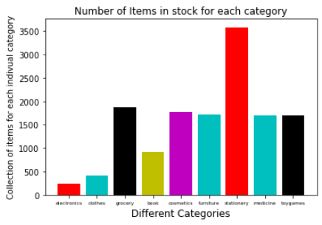
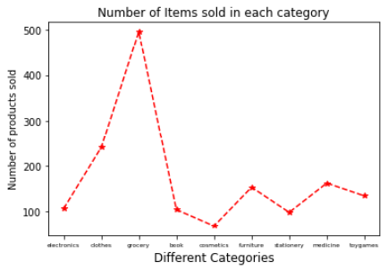
Graphs
1.
2.
3.
4.
5.
6.
7.
8.
9.
10.
11.
12.
13.
14.
15.
16.
17.
18.
19.
20.
21
22.
23.
24.
24.
25.
Number of Items available for each category
Number of Items sold from each category

Slide 31
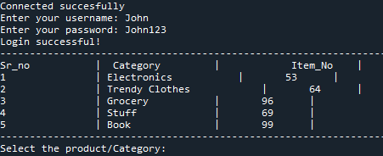
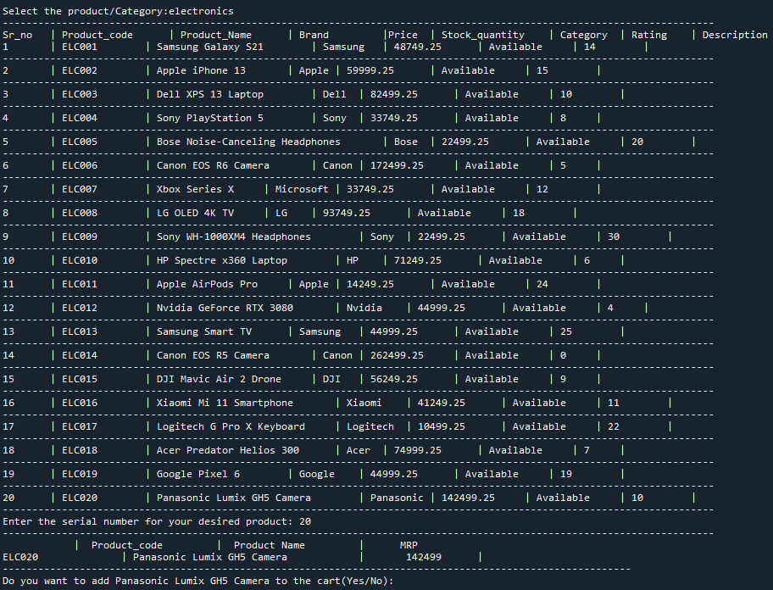
Outputs
1.
2.
3.
4.
5.
6.
7.
8.
9.
10.
11.
12.
13.
14.
15.
16.
17.
18.
19.
20.
21
22.
23.
24.
24.
25.
Phase 1 – Logging in
Phase 1 - Electronics Items

Slide 32
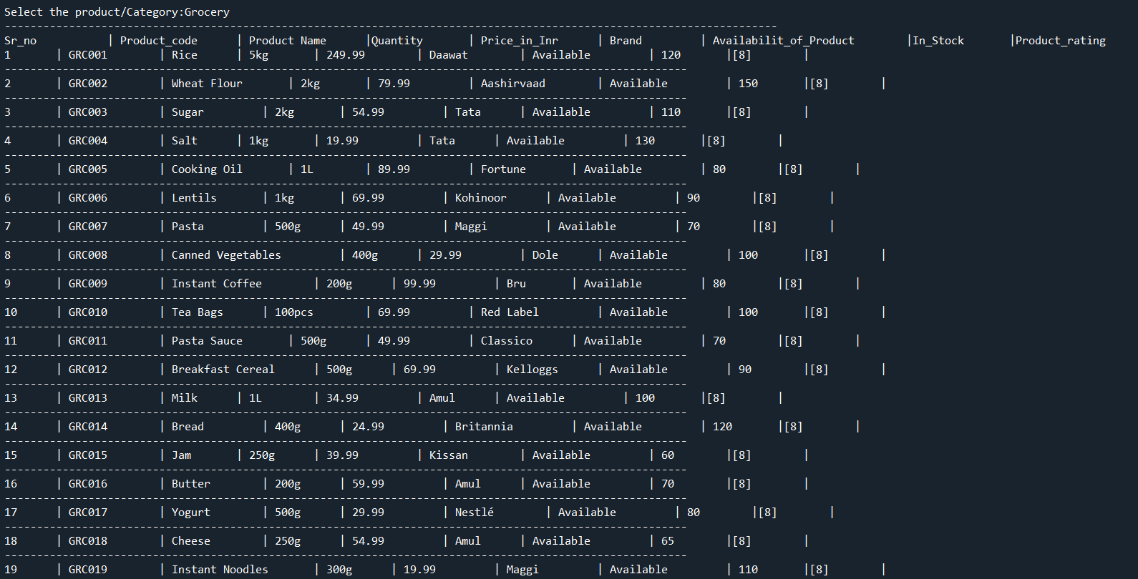
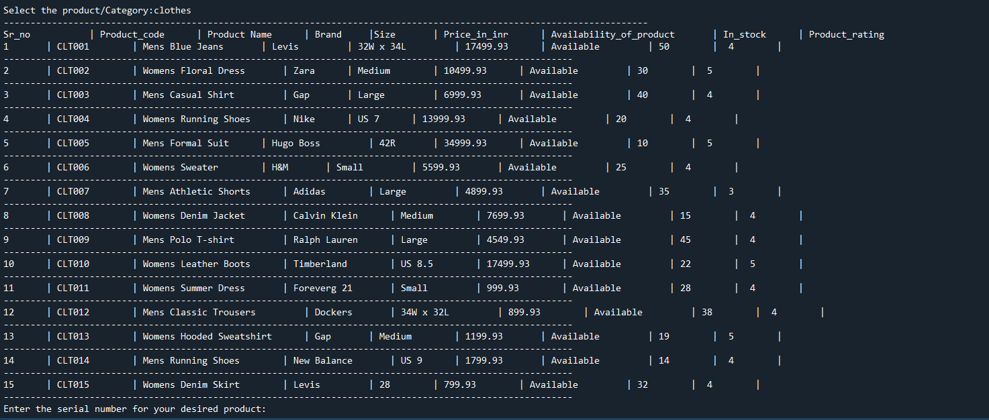
Outputs
1.
2.
3.
4.
5.
6.
7.
8.
9.
10.
11.
12.
13.
14.
15.
16.
17.
18.
19.
20.
21
22.
23.
24.
24.
25.
Phase 1 – Grocery Items
Phase 1 – Clothing Items

Slide 33
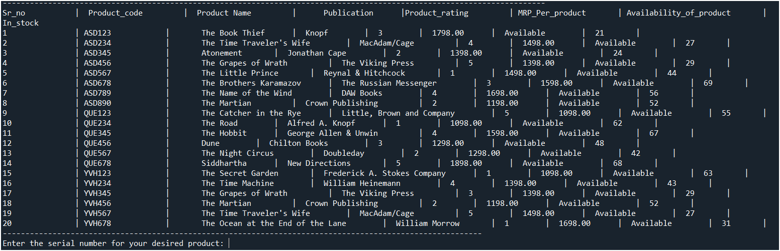
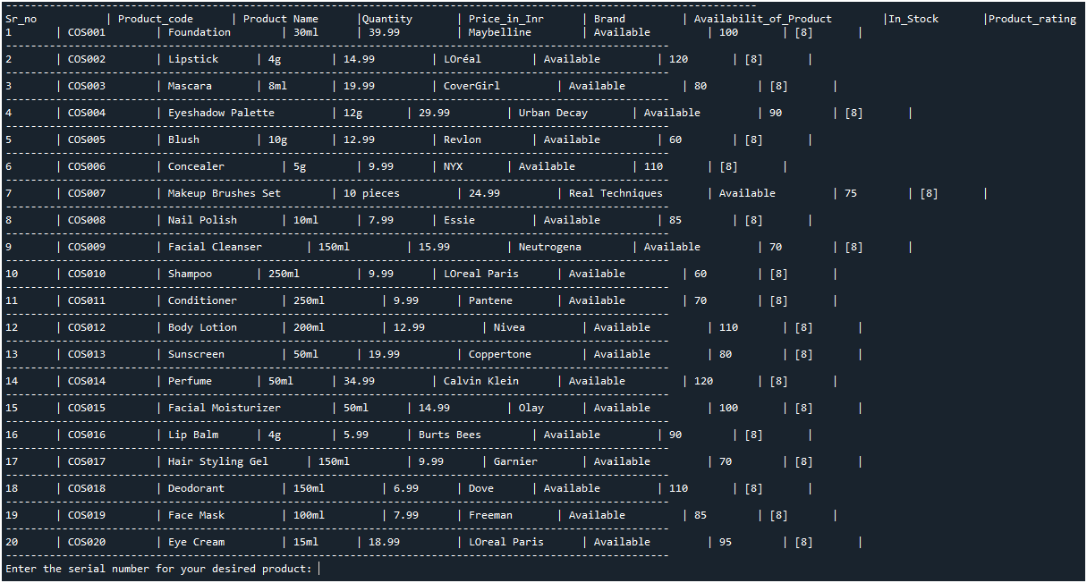
Outputs
1.
2.
3.
4.
5.
6.
7.
8.
9.
10.
11.
12.
13.
14.
15.
16.
17.
18.
19.
20.
21
22.
23.
24.
24.
25.
Phase 1 – Books
Phase 1 – Cosmetics

Slide 34
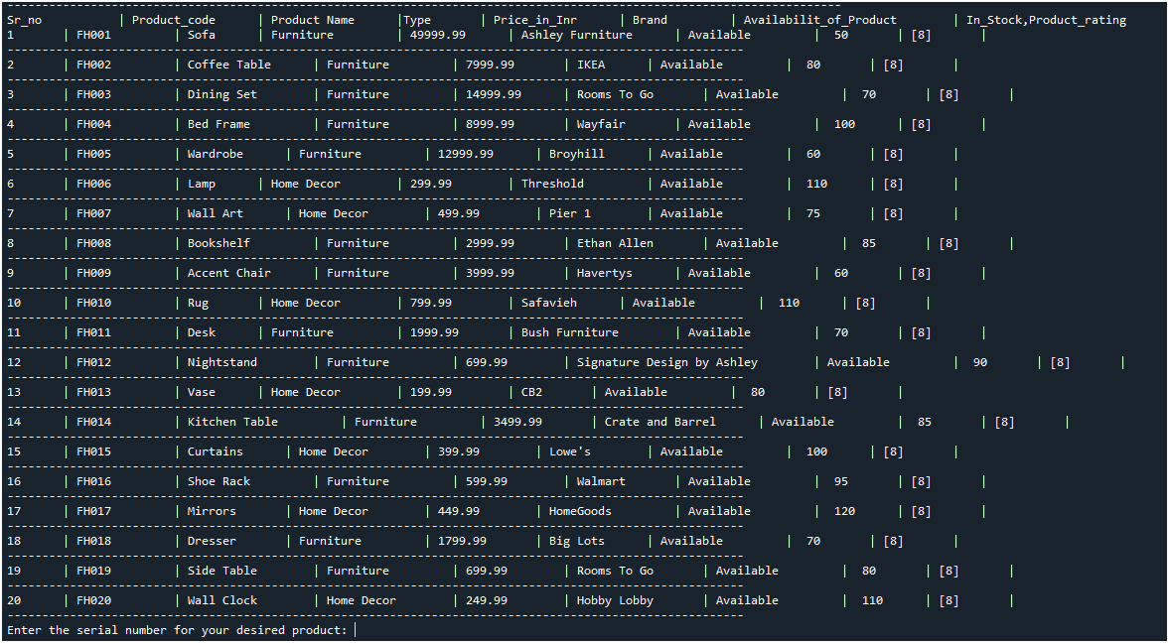
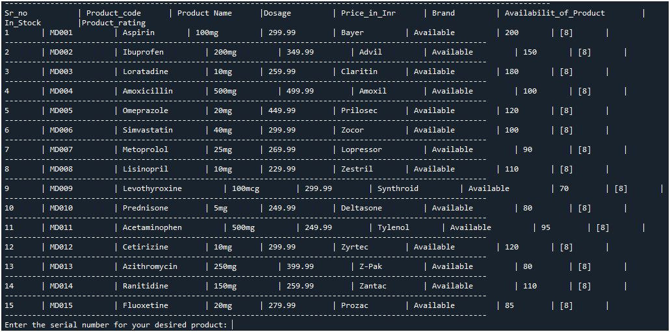
Outputs
1.
2.
3.
4.
5.
6.
7.
8.
9.
10.
11.
12.
13.
14.
15.
16.
17.
18.
19.
20.
21
22.
23.
24.
24.
25.
Phase 1 – Furniture
Phase 1 – Medicinal Items

Slide 35
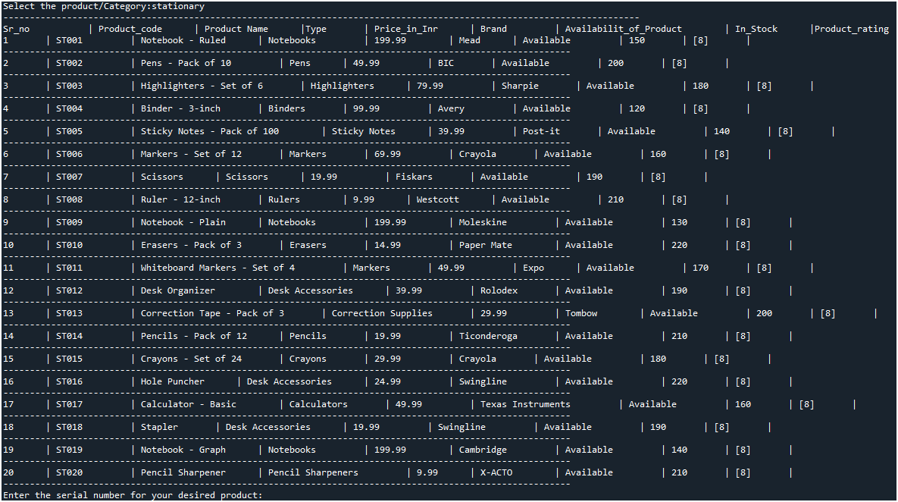
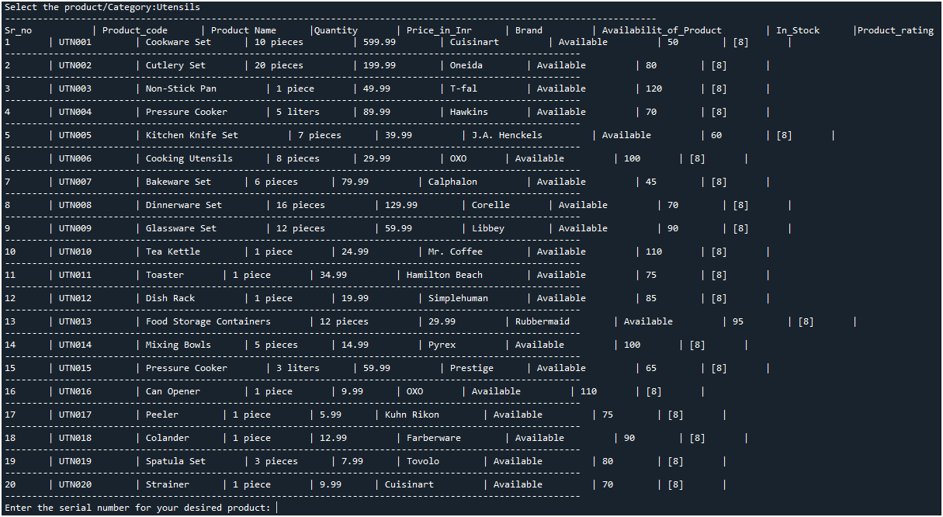
Outputs
1.
2.
3.
4.
5.
6.
7.
8.
9.
10.
11.
12.
13.
14.
15.
16.
17.
18.
19.
20.
21
22.
23.
24.
24.
25.
Phase 1 – Stationary
Phase 1 – Utensils

Slide 36
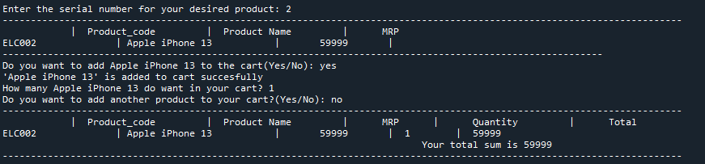
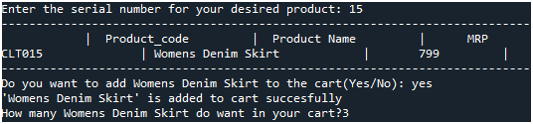
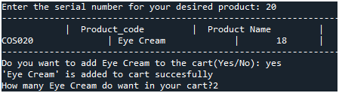
Outputs
1.
2.
3.
4.
5.
6.
7.
8.
9.
10.
11.
12.
13.
14.
15.
16.
17.
18.
19.
20.
21
22.
23.
24.
24.
25.
2. Phase 2 – Adding to cart(Electronic Item)
Phase 2 – Adding to cart(Clothing Item)
Phase 2 – Adding to cart(Cosmetic)

Slide 37
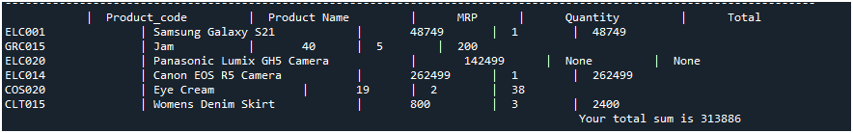
Outputs
1.
2.
3.
4.
5.
6.
7.
8.
9.
10.
11.
12.
13.
14.
15.
16.
17.
18.
19.
20.
21
22.
23.
24.
24.
25.
2. Phase 3 – Checking Out

Slide 38
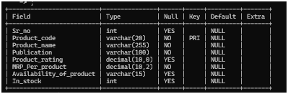
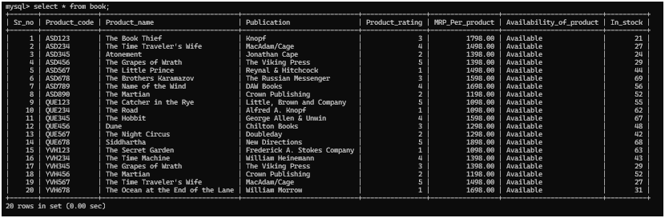
MYSQL Tables
1.
2.
3.
4.
5.
6.
7.
8.
9.
10.
11.
12.
13.
14.
15.
16.
17.
18.
19.
20.
21
22.
23.
24.
24.
25.
Book(Structure)
Book(Table)

Slide 39
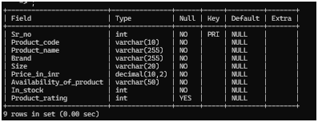
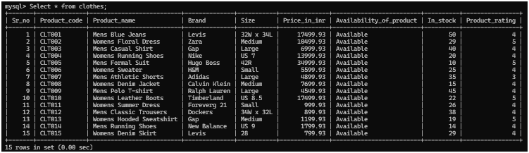
MYSQL Tables
1.
2.
3.
4.
5.
6.
7.
8.
9.
10.
11.
12.
13.
14.
15.
16.
17.
18.
19.
20.
21
22.
23.
24.
24.
25.
Clothes(Structure)
Clothes(Table)

Slide 40
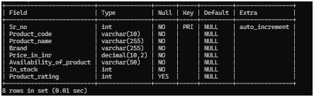
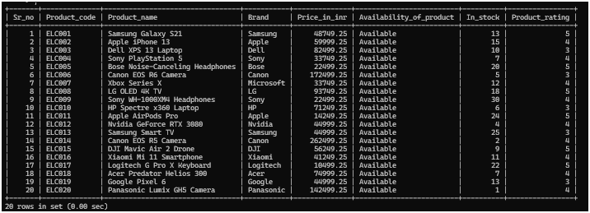
MYSQL Tables
1.
2.
3.
4.
5.
6.
7.
8.
9.
10.
11.
12.
13.
14.
15.
16.
17.
18.
19.
20.
21
22.
23.
24.
24.
25.
Electronics(Structure)
Electronics(Table)

Slide 41
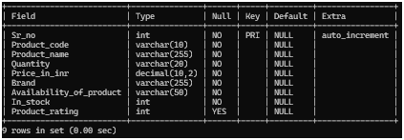
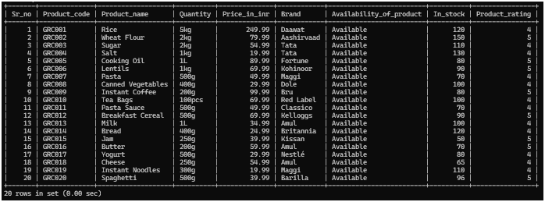
MYSQL Tables
1.
2.
3.
4.
5.
6.
7.
8.
9.
10.
11.
12.
13.
14.
15.
16.
17.
18.
19.
20.
21
22.
23.
24.
24.
25.
Grocery(Structure)
Grocery(Table)

Slide 42
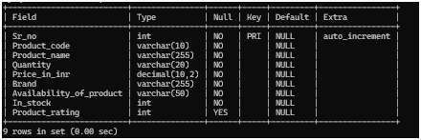
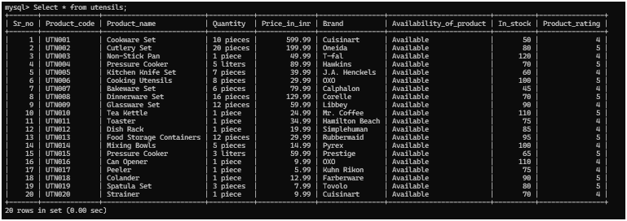
MYSQL Tables
1.
2.
3.
4.
5.
6.
7.
8.
9.
10.
11.
12.
13.
14.
15.
16.
17.
18.
19.
20.
21
22.
23.
24.
24.
25.
Utensils(Structure)
Utensils(Table)

Slide 43
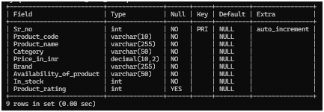
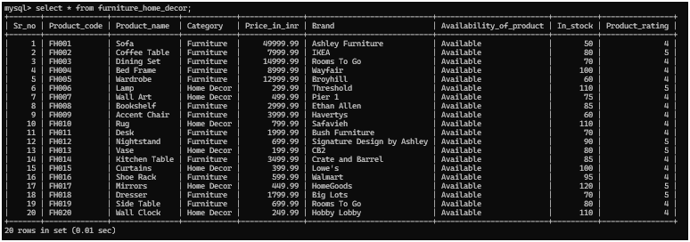
MYSQL Tables
1.
2.
3.
4.
5.
6.
7.
8.
9.
10.
11.
12.
13.
14.
15.
16.
17.
18.
19.
20.
21
22.
23.
24.
24.
25.
Furniture(Structure)
Furniture(Table)

Slide 44
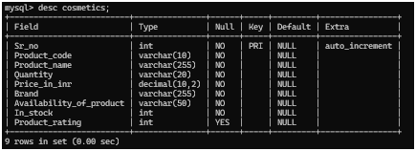
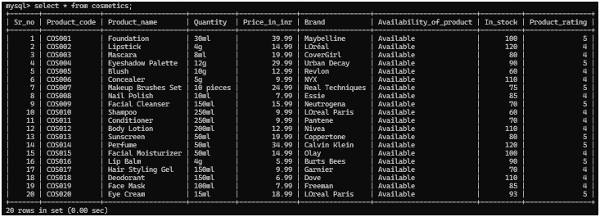
MYSQL Tables
1.
2.
3.
4.
5.
6.
7.
8.
9.
10.
11.
12.
13.
14.
15.
16.
17.
18.
19.
20.
21
22.
23.
24.
24.
25.
Cosmetics(Structure)
Cosmetics(Table)

Slide 45
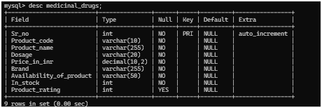
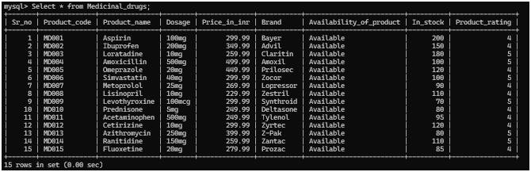
MYSQL Tables
1.
2.
3.
4.
5.
6.
7.
8.
9.
10.
11.
12.
13.
14.
15.
16.
17.
18.
19.
20.
21
22.
23.
24.
24.
25.
Medicines(Structure)
Medicines(Table)

Slide 46

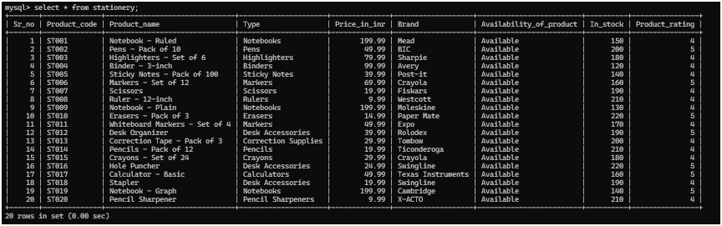
MYSQL Tables
1.
2.
3.
4.
5.
6.
7.
8.
9.
10.
11.
12.
13.
14.
15.
16.
17.
18.
19.
20.
21
22.
23.
24.
24.
25.
Stationery(Structure)
Stationery(Table)

